Slide 1
Heuristic classifier
November 2024
Andrea Corrado

Slide 2
Outline
Why building a heuristic classifier
Knowledge on roving signals: recap
Data preparation
Heuristic classifier: pseudo code
Performance
Conclusions
Appendices

Slide 3
Outline
Why building a heuristic classifier
Knowledge on roving signals: recap
Data preparation
Heuristic classifier: pseudo code
Performance
Conclusions
Appendices

Slide 4
Why building a heuristic classifier
So far:
A filtering pipeline has been proposed
Data have been aligned respect to a common point
Data have been cleaned from misleading signals
Now it’s possible to proceed with building a Heuristic Classifier.

Slide 5
Why building a heuristic classifier
Problem
Which model could act as baseline for building and comparing any other one?
In literature there’s no evidence of AVNRT roving signals classification
Proposed solution
So, a first classifier, which could cover this role, could be a heuristic one based on prior information on these signals
Aim
Building a logical set of rules to classify roving signals exploiting the prior on them

Slide 6
Outline
Why building a heuristic classifier
Knowledge on roving signals: recap
Data preparation
Heuristic classifier: pseudo code
Performance
Conclusions
Appendices

Slide 7
Knowledge on roving signals: recap
Map A: indifferent
Atrial wave amplitude >0.5 mv
Simple and biphasic shape of atrial wave
No slow-path signal
Minor presence of the Ventricular component
Map B: effective
Complex atrial component within 0.1 and 0.3 mV
Higher ventricular component
Map C: dangerous
3 components: atrial activity, ventricular activity and His Bundle passage
Not fixed proportions between atrial and ventricular components
Clear and biphasic atrial component

Slide 8
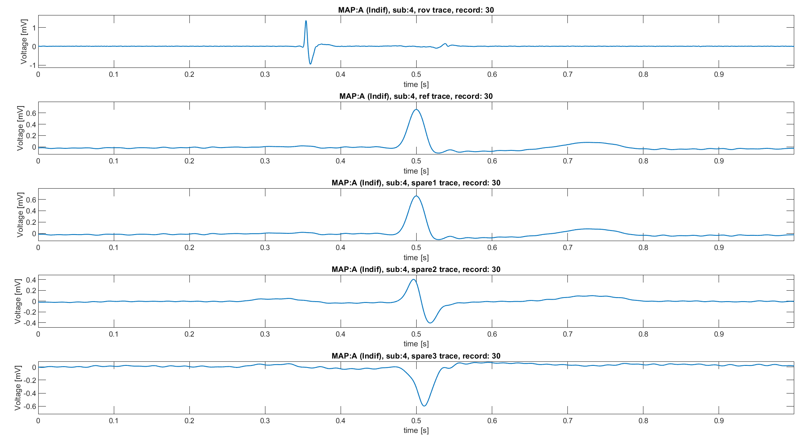
Knowledge on roving signals: recap
Map A
Atrial wave amplitude >0.5 mv
Simple and biphasic shape of atrial wave
No slow-path signal
Minor presence of the Ventricular component
ECG 1
ECG 1
Used for building the classifier
ECG 2
ECG 3

Slide 9
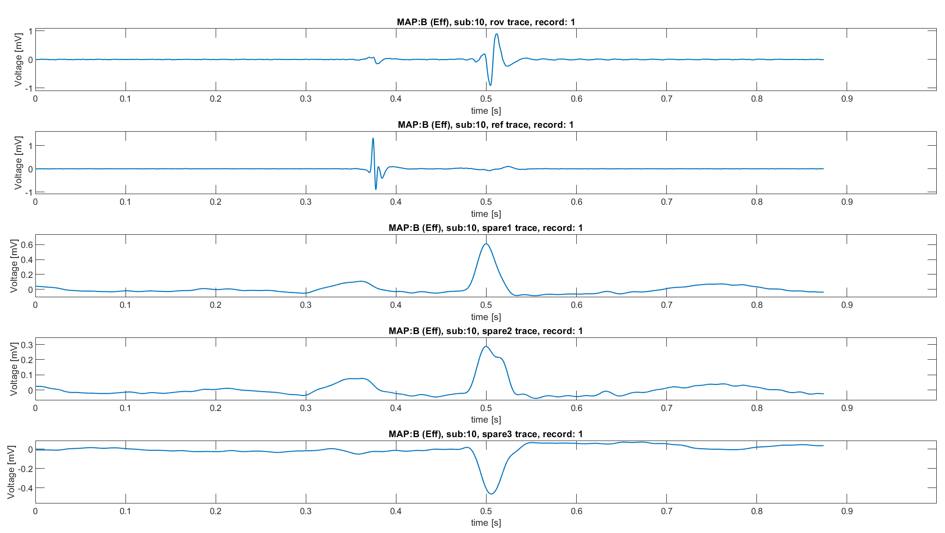
Knowledge on roving signals: recap
Map B
Complex atrial component within 0.1 and 0.3 mV
Higher ventricular component
CS 3-4
Used for building the classifier
ECG 2
ECG aVF
ECG V1

Slide 10
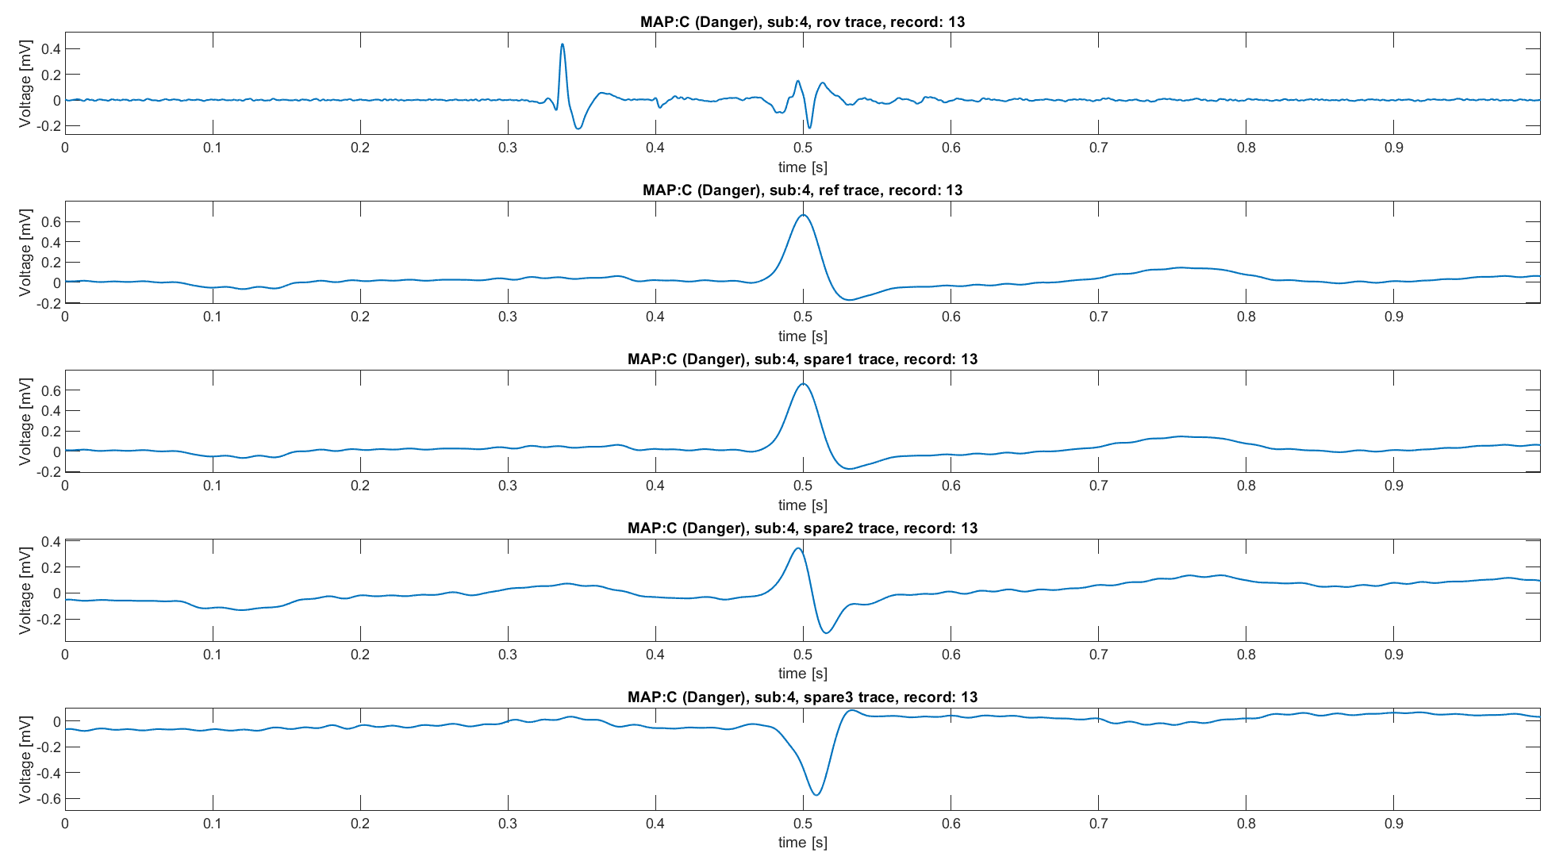
Knowledge on roving signals: recap
Map C
Clear and biphasic atrial component
3 components: atrial activity, ventricular activity and His Bundle passage
Not fixed proportions between atrial and ventricular components
ECG 1
ECG 1
Used for building the classifier
ECG 2
ECG 3

Slide 11
Outline
Why building a heuristic classifier
Knowledge on roving signals: recap
Data preparation
Heuristic classifier: pseudo code
Performance
Conclusions
Appendices

Slide 12
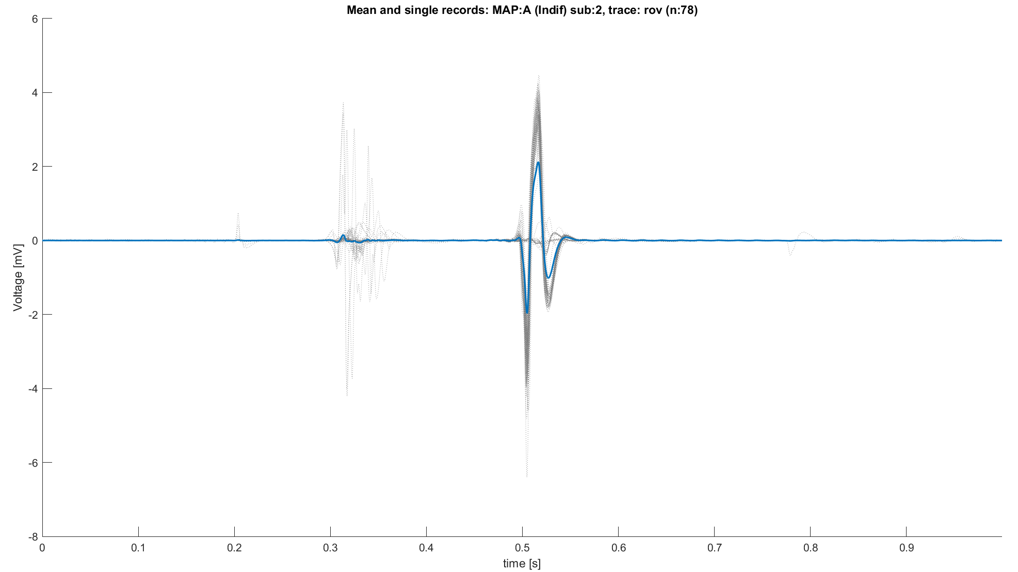
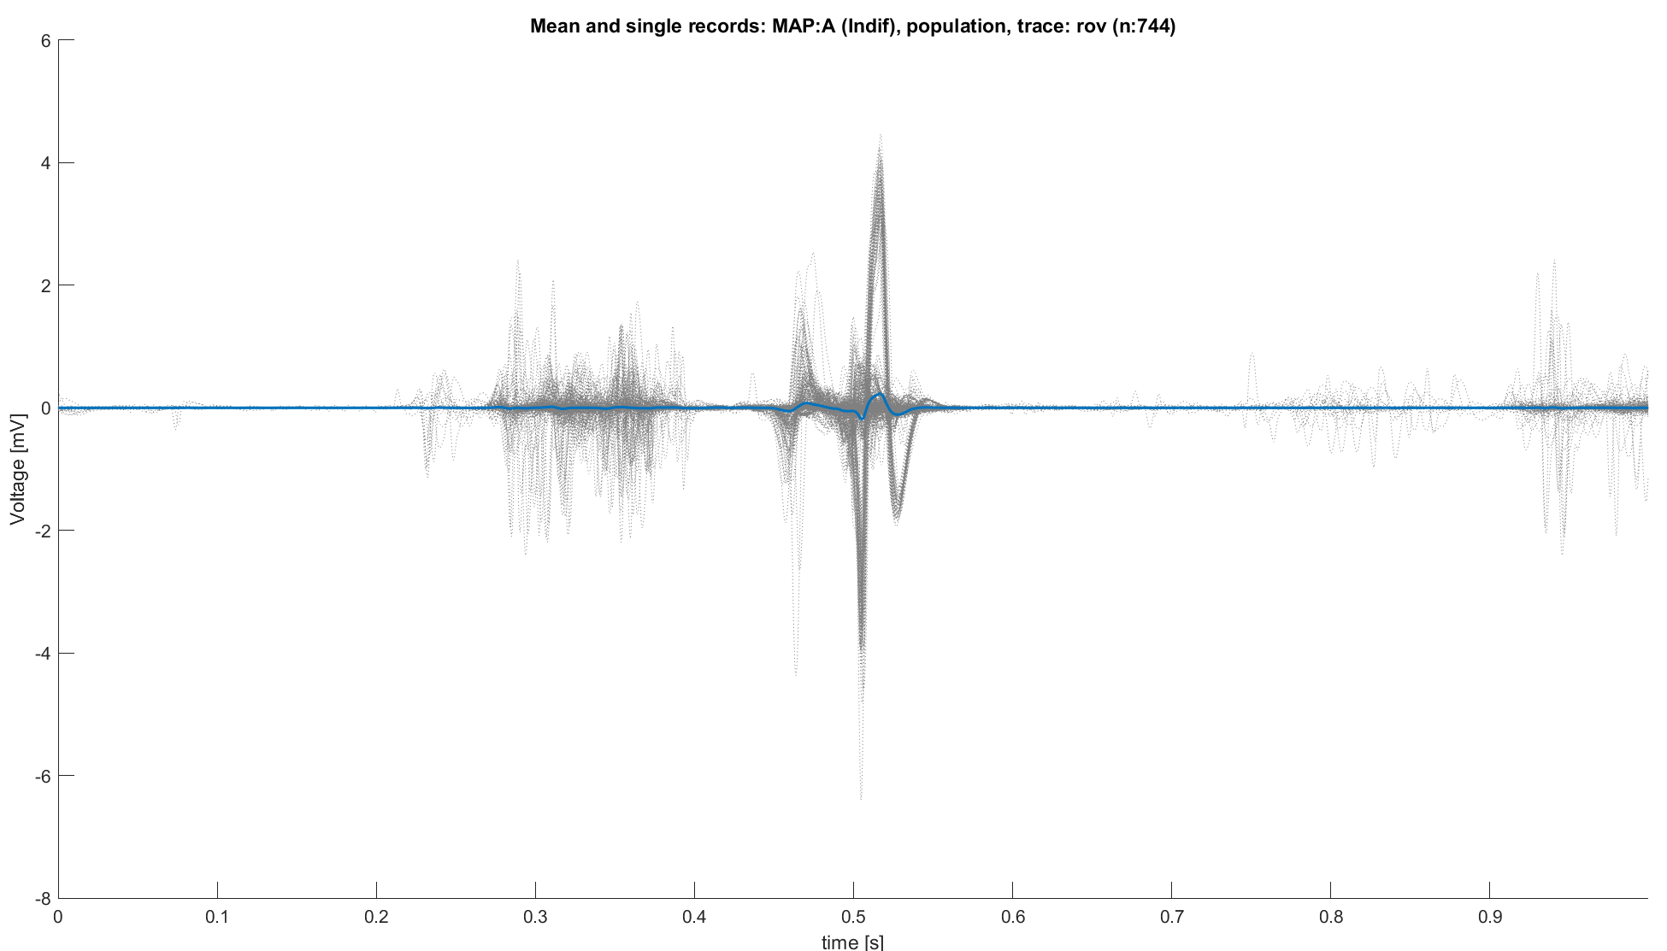
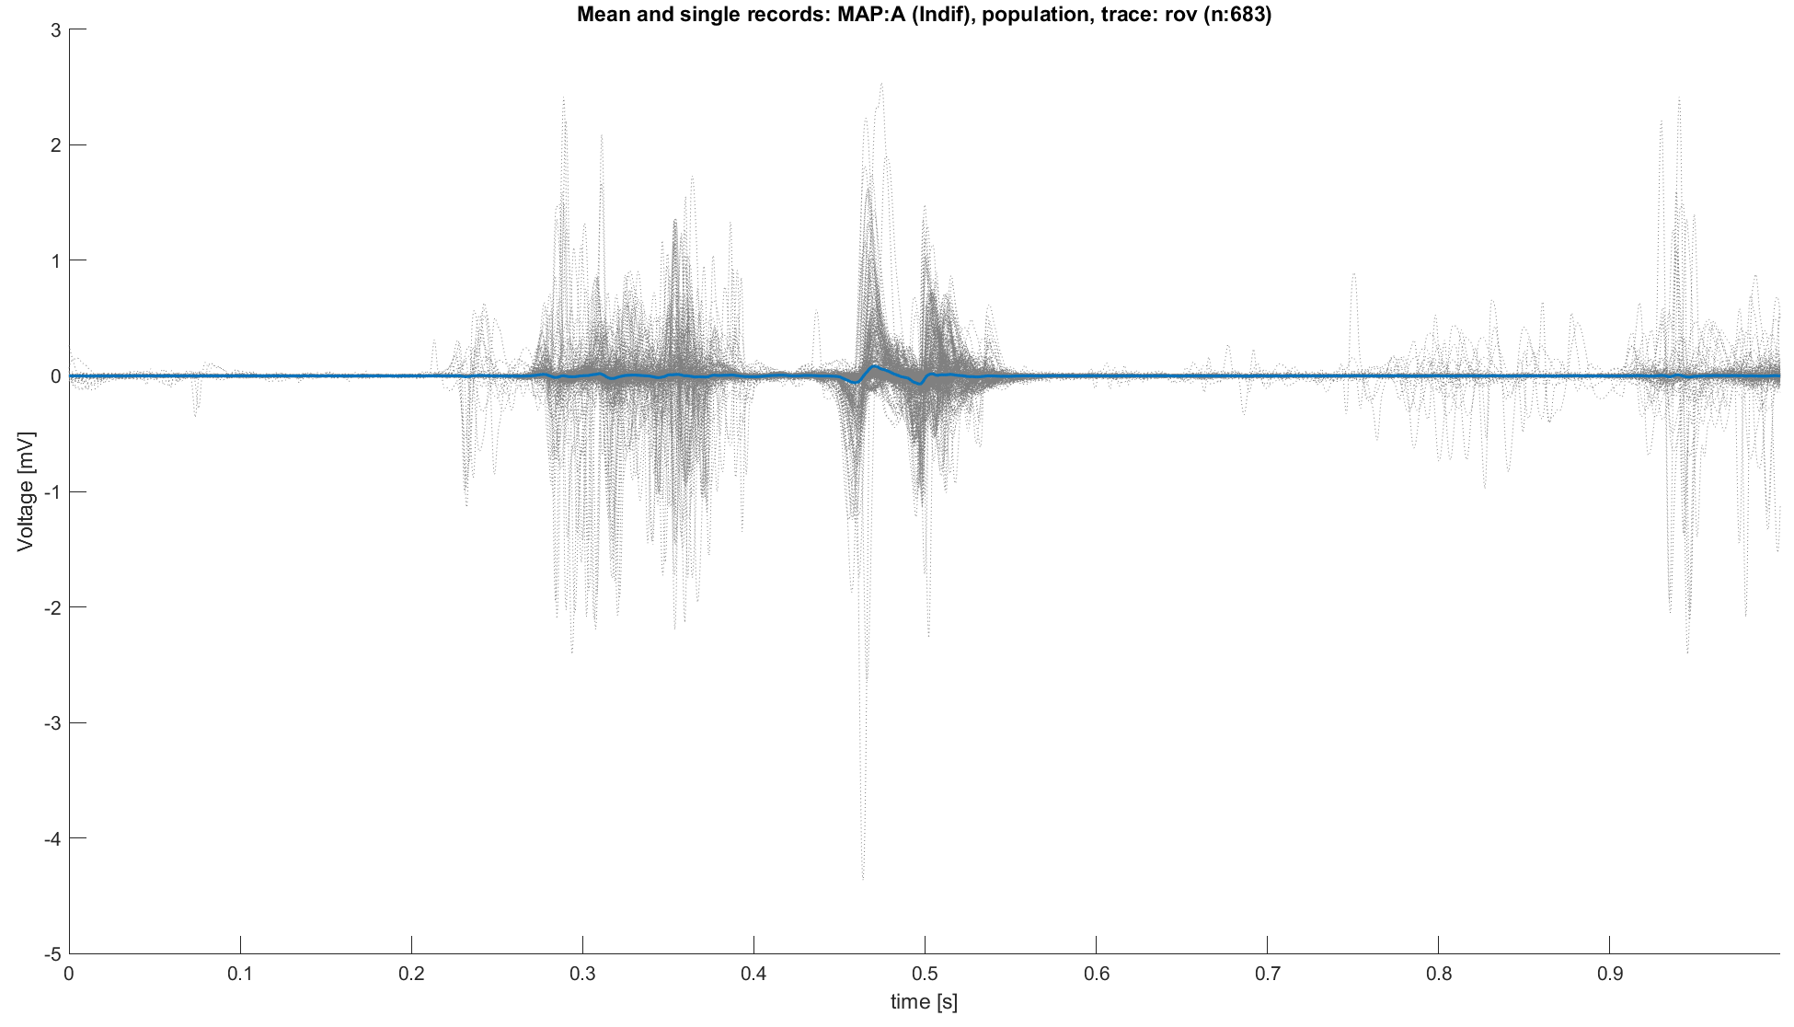
Data preparation: sub 2 exclusion
Before proceeding, a first observation should focus on the consistency of the signals with the expected behavior defined by the classification map
Subject 2 has almost the totality of MAP A signals with clearly MAP B characteristics.
So, while awaiting further understanding of how to interpret these signals, subject 2 has been excluded from the analysis.
MAP A signals with sub 2
MAP A signals without sub 2
Ref trace: ECG L1 with R peak on 0.5s

Slide 13
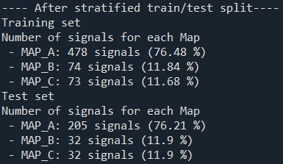
Stratified train/test split
Of the 894 remaining signals:
683 are MAP A (76.40%)
106 are MAP B (11.86%)
105 are MAP C (11.74%)
Thus, the following conclusions could be done:
Unbalanced dataset towards MAP A
Stratified train/test splitting is necessary
Done with a 70-30% split
Total 625
Total 269

Slide 14
Outline
Why building a heuristic classifier
Knowledge on roving signals: recap
Data preparation
Heuristic classifier: pseudo code
Performance
Conclusions
Appendices

Slide 15
Heuristic classifier: pseudo code
For each roving trace (post-alignment):
Divide the trace in three segments:
Atrial: t<0.38s
Ventricular: after t>0.42
His bundle: 0.38<t<0.42
Compute the absolute value of the segment, then into each (modulus) segment find the maximum:
For atrial and ventricular phase take the maximum as it is
For His phase, consider the maximum and compare it with a threshold,
Then apply the following set of rules:
Is the His Peak above threshold?
No
Is the atrial peak > 0.5 mV?
No
Is 0.1< atrial peak<0.3 ?
No
Is atrial peak > ventricular peak?
No
NB: in this way MAP B, effective, is harder to be chosen, leading to a more “conservative” algorithm, as is should be the surgeon.
MAP A, indifferent, is chosen if atrial peak is higher than the threshold or if the higher than the ventricular one.
Finally, MAP C, dangerous, is chosen as first one if there’s an over-threshold peak into the His bundle.
MAP B
Yes
Yes
Yes
Yes
MAP C
MAP A
MAP B
MAP A

Slide 16
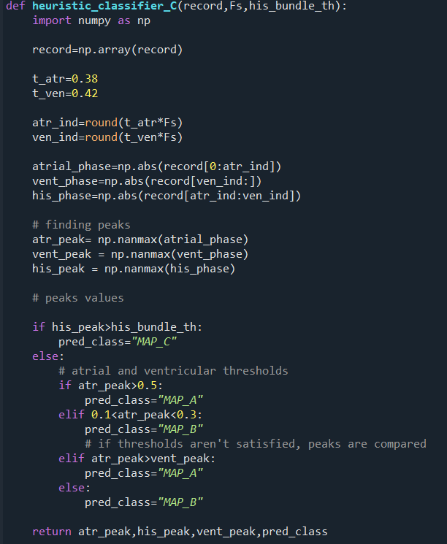
Code functioning
The given record is divided into three segments and the modulus is taken
Atrial phase: abs(record[t=0 : t=0.38])
Ventricular phase: abs(record[t=0.42 : t=t_end])
His phase: abs(record[t=0.38 : t=0.42])
Into each segment the maximum is evaluated
Then a first block of rules use priors on thresholds :
If his_peak>th_his→ MAP_C
Else:
Elif atrial_peak>0.5→ MAP_A
Elif 0.1<atrial_peak<0.3→ MAP_B
And one utilizes the information regarding the dominance between the atrial and ventricular peaks
Elif atrial_peak>vent_peak→ MAP_A
Else → MAP_B

Slide 17
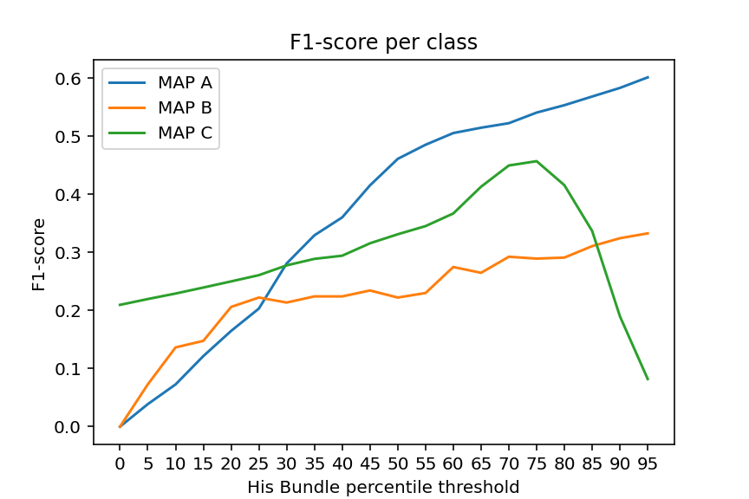
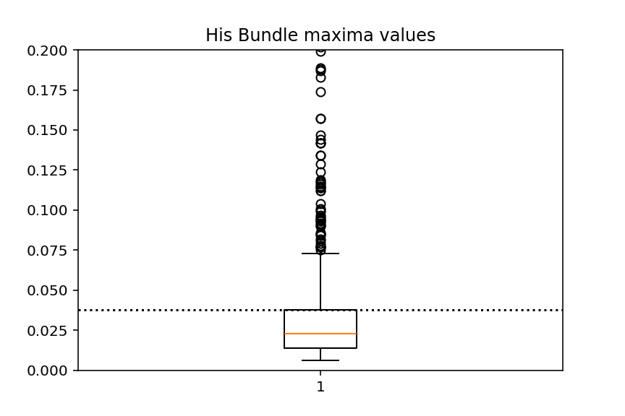
His threshold tuning
His peak threshold is fixed as a percentile of the distribution of maxima points around the His Peak of the training signals.
To do it:
From each record the modulus of the His segment is taken
His phase: abs(record[t=0.38 : t=0.42])
Boundaries are fixed as wide as possible without f1-score reduction.
Then the maximum of the segment is evaluated and saved into a vector of maximum_points
For each class, the F1-score value is evaluated as a function of the threshold, leading to the plot on the right.
Higher class F1-score combination is reached with a threshold equal to the 75th percentile
Finally, the value of the threshold is saved for being used in the classification phase
In conclusion, the threshold was 0.0377 mV
Threshold position into the distribution

Slide 18
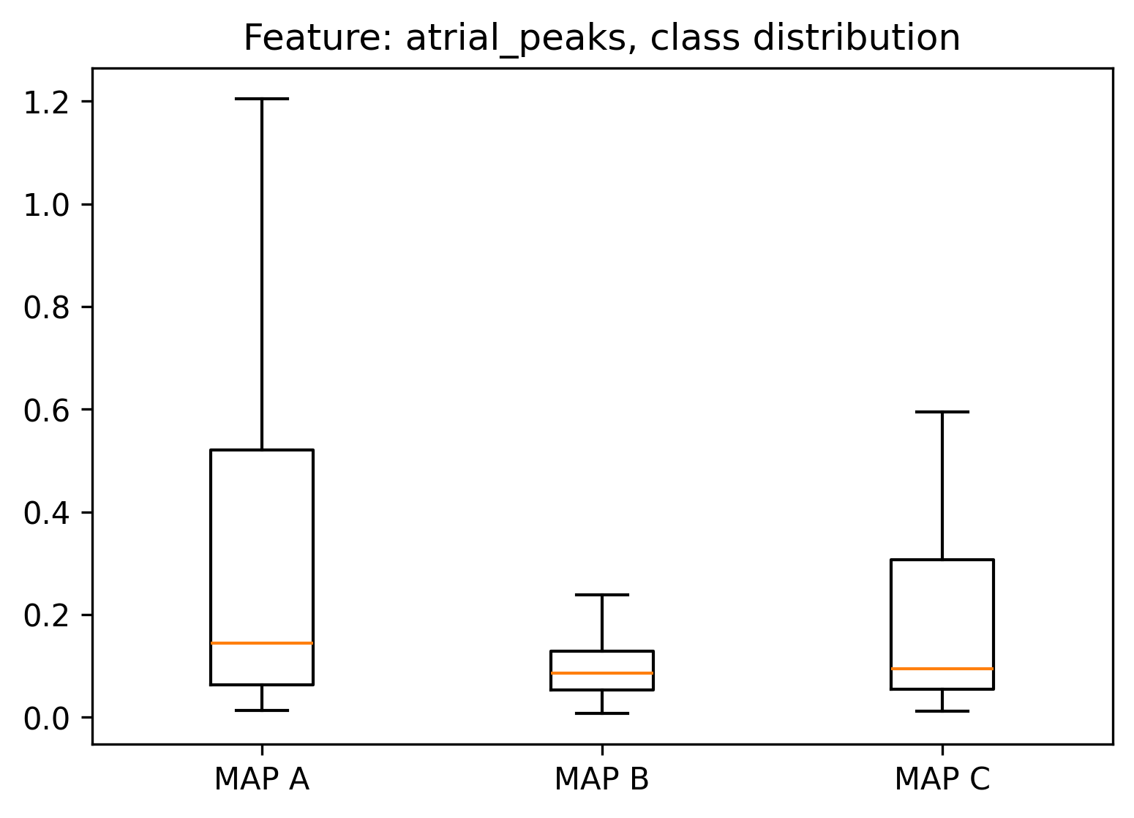
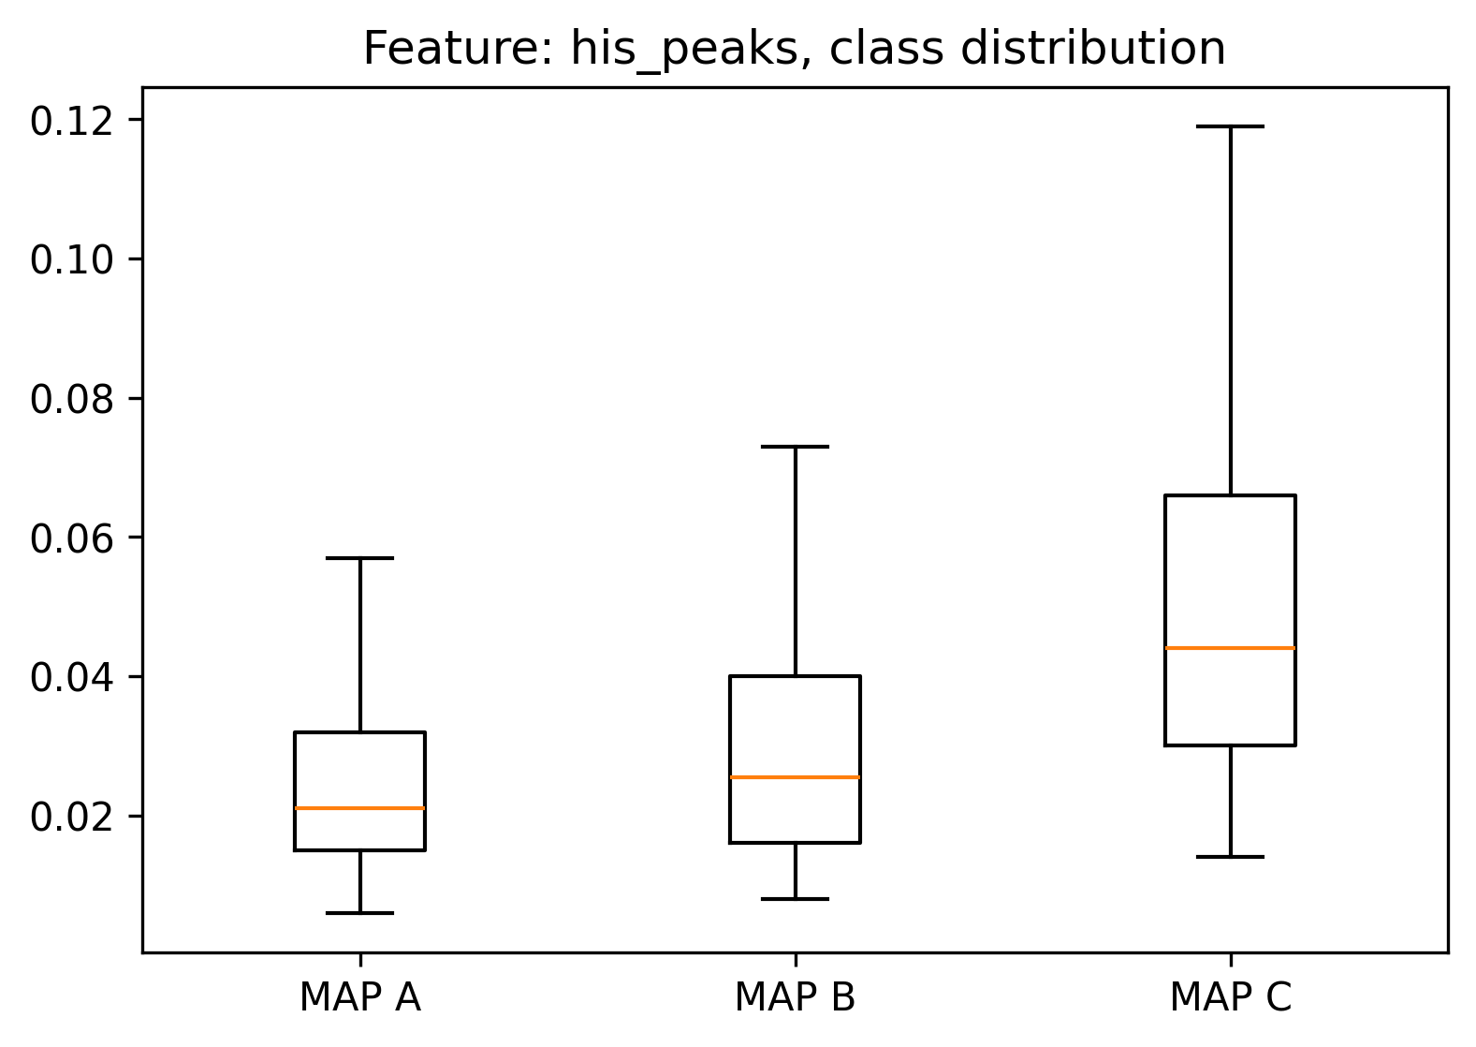
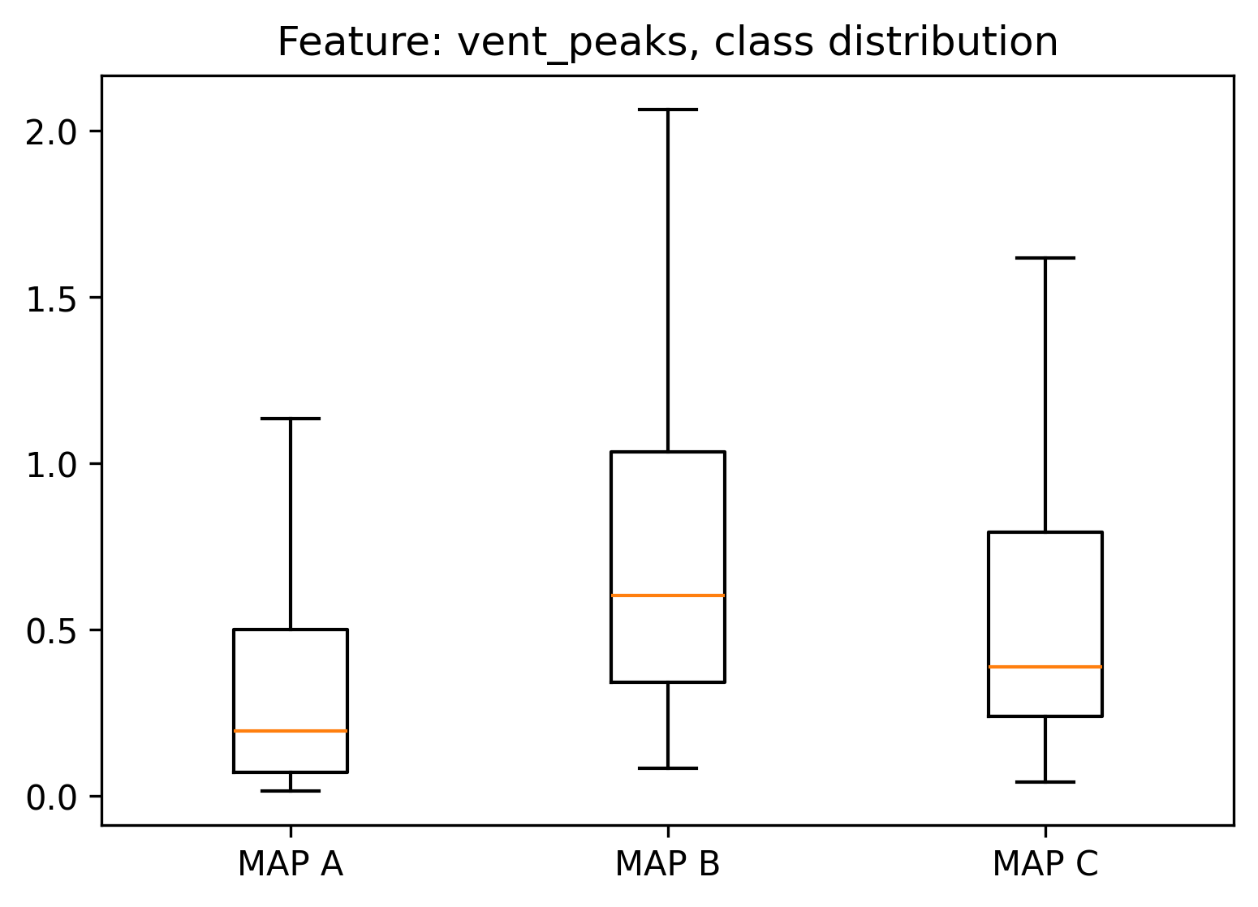
Are peaks discriminative?
To answer, atrial, His and ventricular peaks (maximum values into segments) have been valuated for each MAP:
Atrial peak does not seem to be discriminative of MAP A from MAP B
His peaks seem to be discriminative respect to MAP A, but there’s a certain intersection with MAP B
Ventricular peaks doesn’t allow to clearly distinguish between MAP B and MAP A.

Slide 19
Outline
Why building a heuristic classifier
Knowledge on roving signals: recap
Data preparation
Heuristic classifier: pseudo code
Performance
Conclusions
Appendices

Slide 20
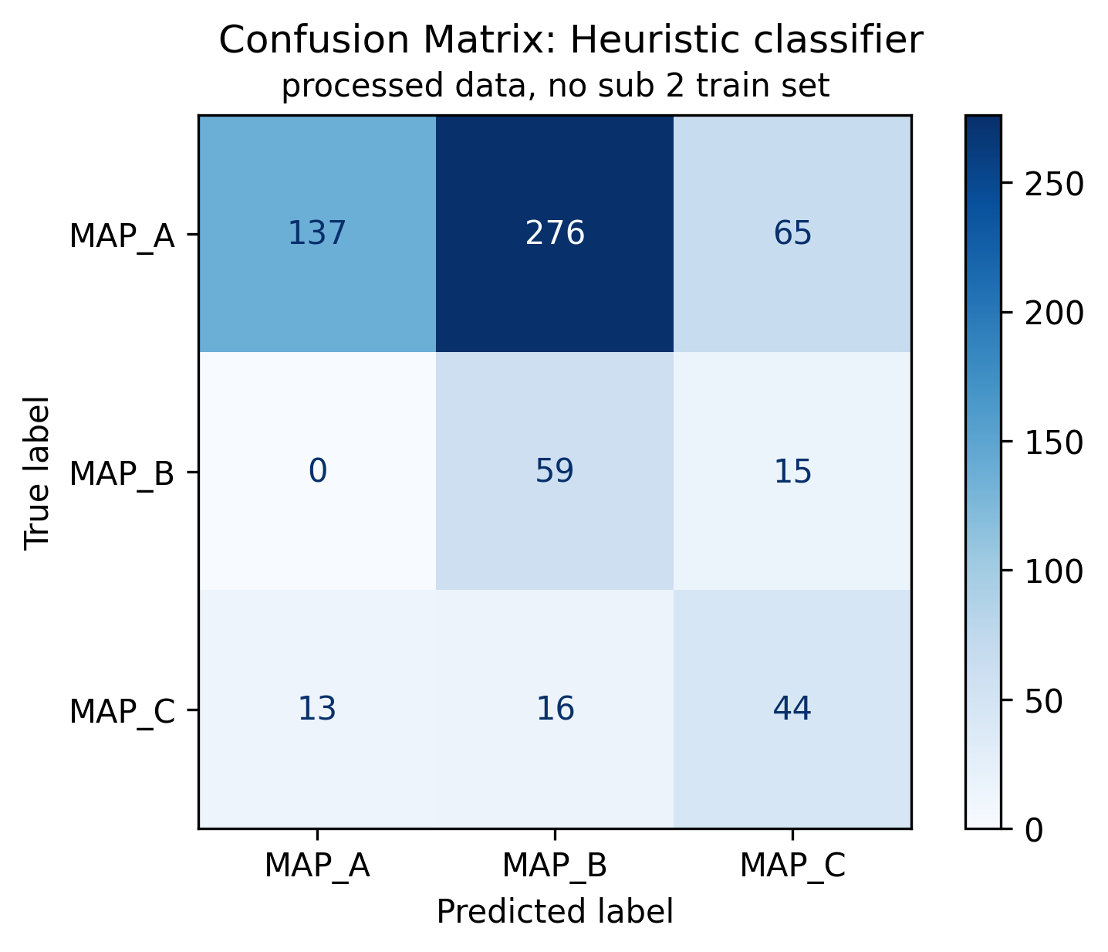
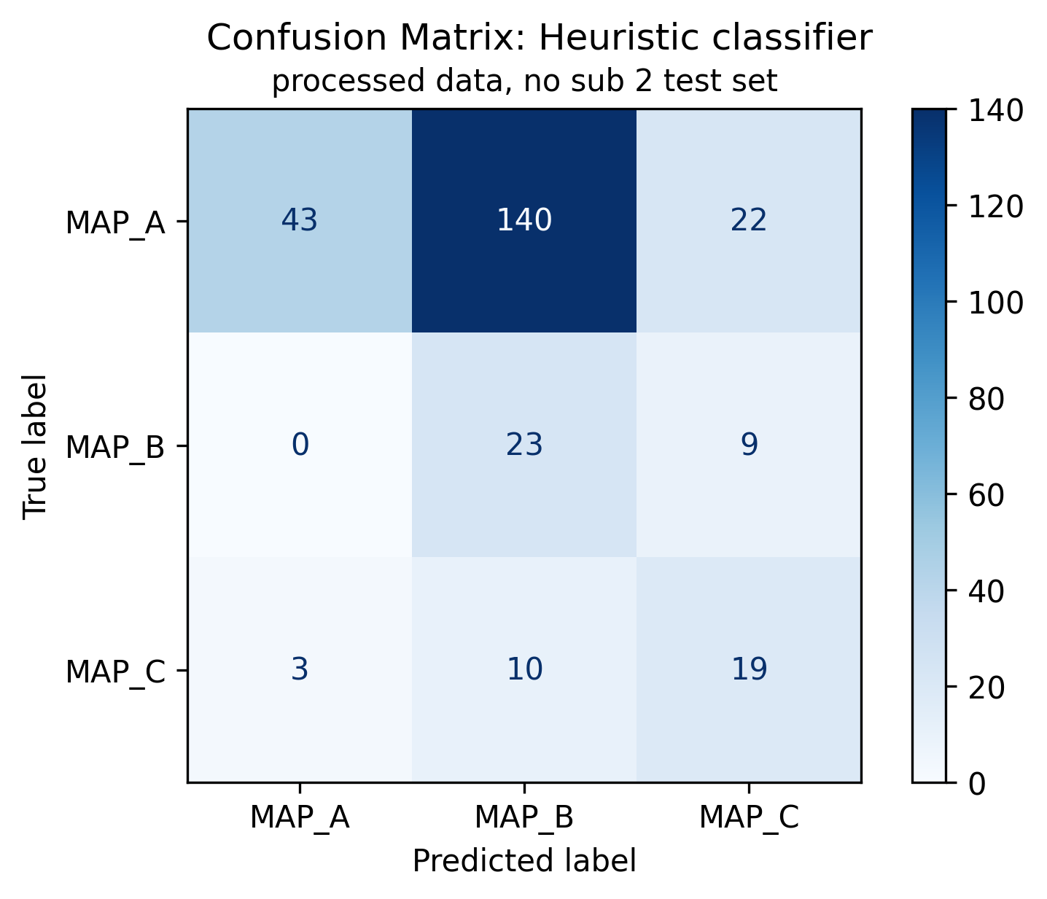
Heuristic classifier: results on original signals
Performance have been evaluated using confusion matrix and standard metrics

Slide 21




Heuristic classifier: results on train set
 | Precision | Recall | F1-score | support
Map A | 0.91 | 0.29 | 0.44 | 478
Map B | 0.17 | 0.80 | 0.28 | 74
Map C | 0.35 | 0.60 | 0.45 | 73
Accuracy |  |  | 0.38
Macro avg | 0.48 | 0.56 | 0.39 | 625
Weighted avg | 0.76 | 0.38 | 0.42 | 625
$$Precision=\frac{TP}{TP+FP}$$
$$Recall=\frac{TP}{TP+FN}$$
$$f1_{score}=2\frac{Precision ∗Recall}{Precision+Recall}$$
$$Accuracy=\frac{TP+TN}{TP+TN+FP+FN}$$

Slide 22
Heuristic classifier: results on test set
 | Precision | Recall | F1-score | support
Map A | 0.93 | 0.21 | 0.34 | 205
Map B | 0.13 | 0.72 | 0.22 | 32
Map C | 0.38 | 0.59 | 0.46 | 32
Accuracy |  |  | 0.32
Macro avg | 0.48 | 0.51 | 0.34 | 269
Weighted avg | 0.77 | 0.32 | 0.34 | 269
$$Precision=\frac{TP}{TP+FP}$$
$$Recall=\frac{TP}{TP+FN}$$
$$f1_{score}=2\frac{Precision ∗Recall}{Precision+Recall}$$
$$Accuracy=\frac{TP+TN}{TP+TN+FP+FN}$$

Slide 23
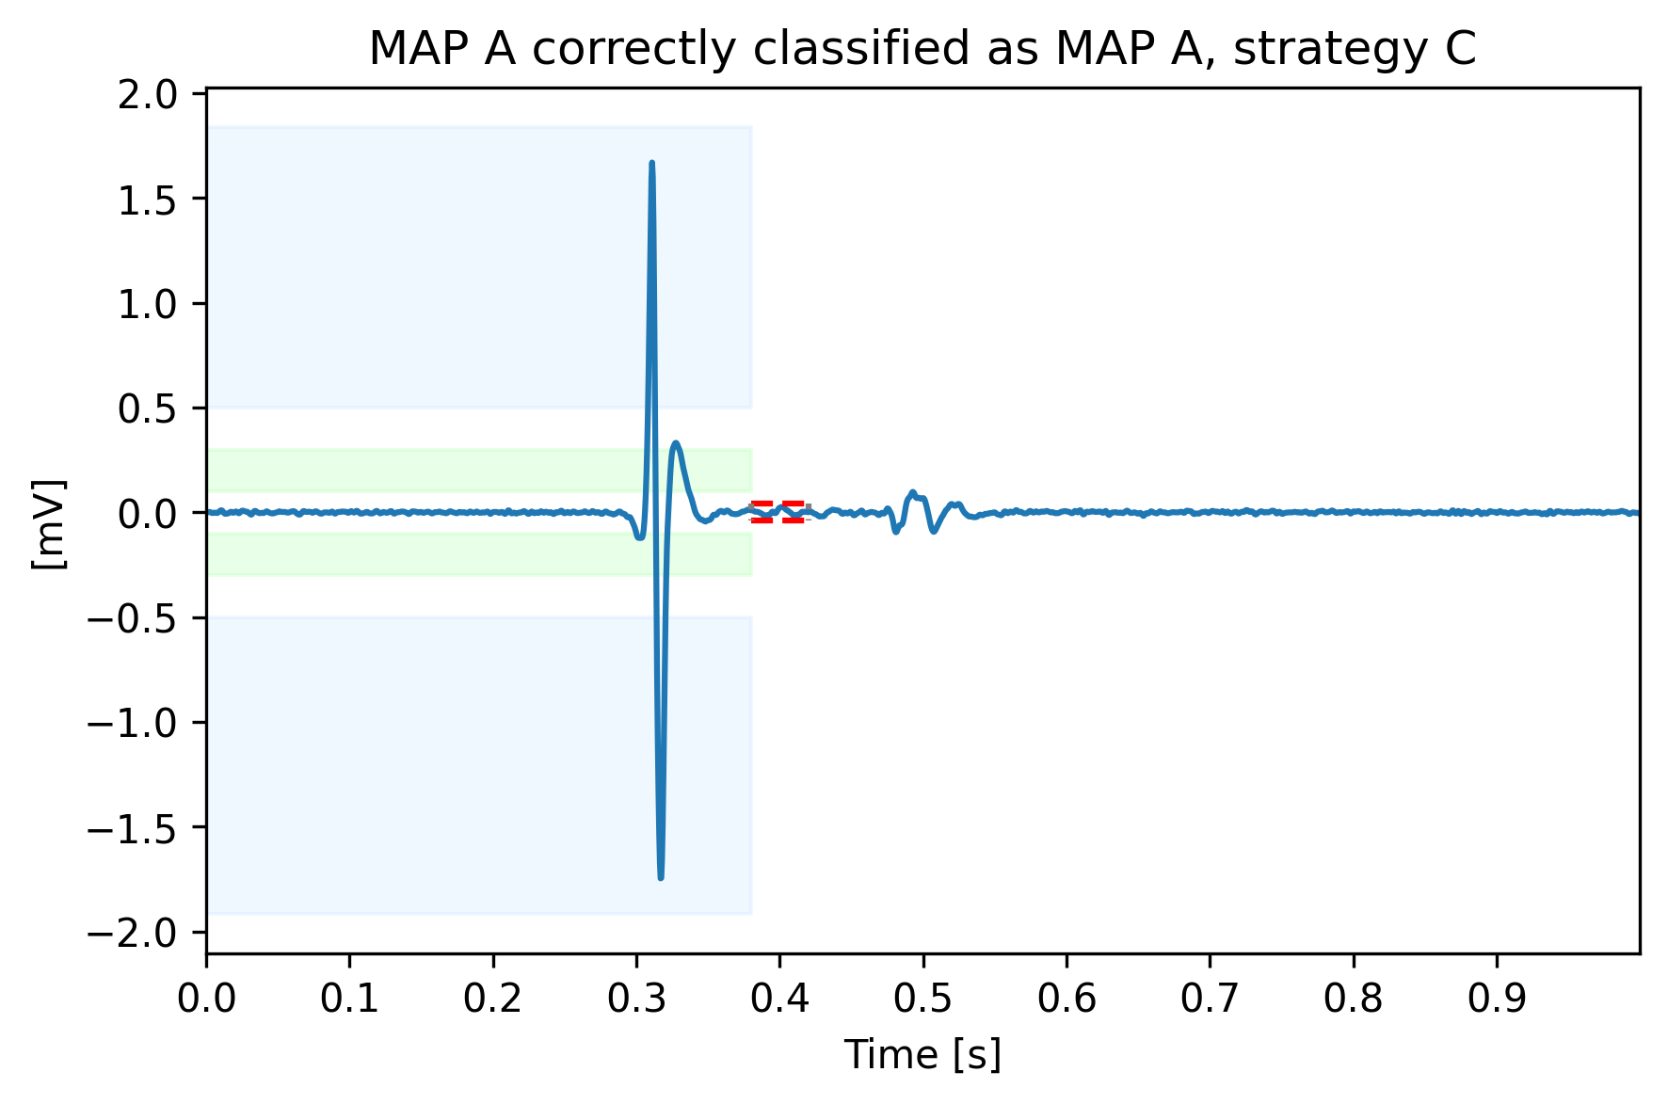
Correctly classified example 1
MAP A correctly classified
The algorithm recognize as majoritarian the atrial peak (in modulus)
Blue boxes: MAP A atrial peak threshold, green boxes MAP B atrial threshold, red dashed lines his peak thresholds

Slide 24
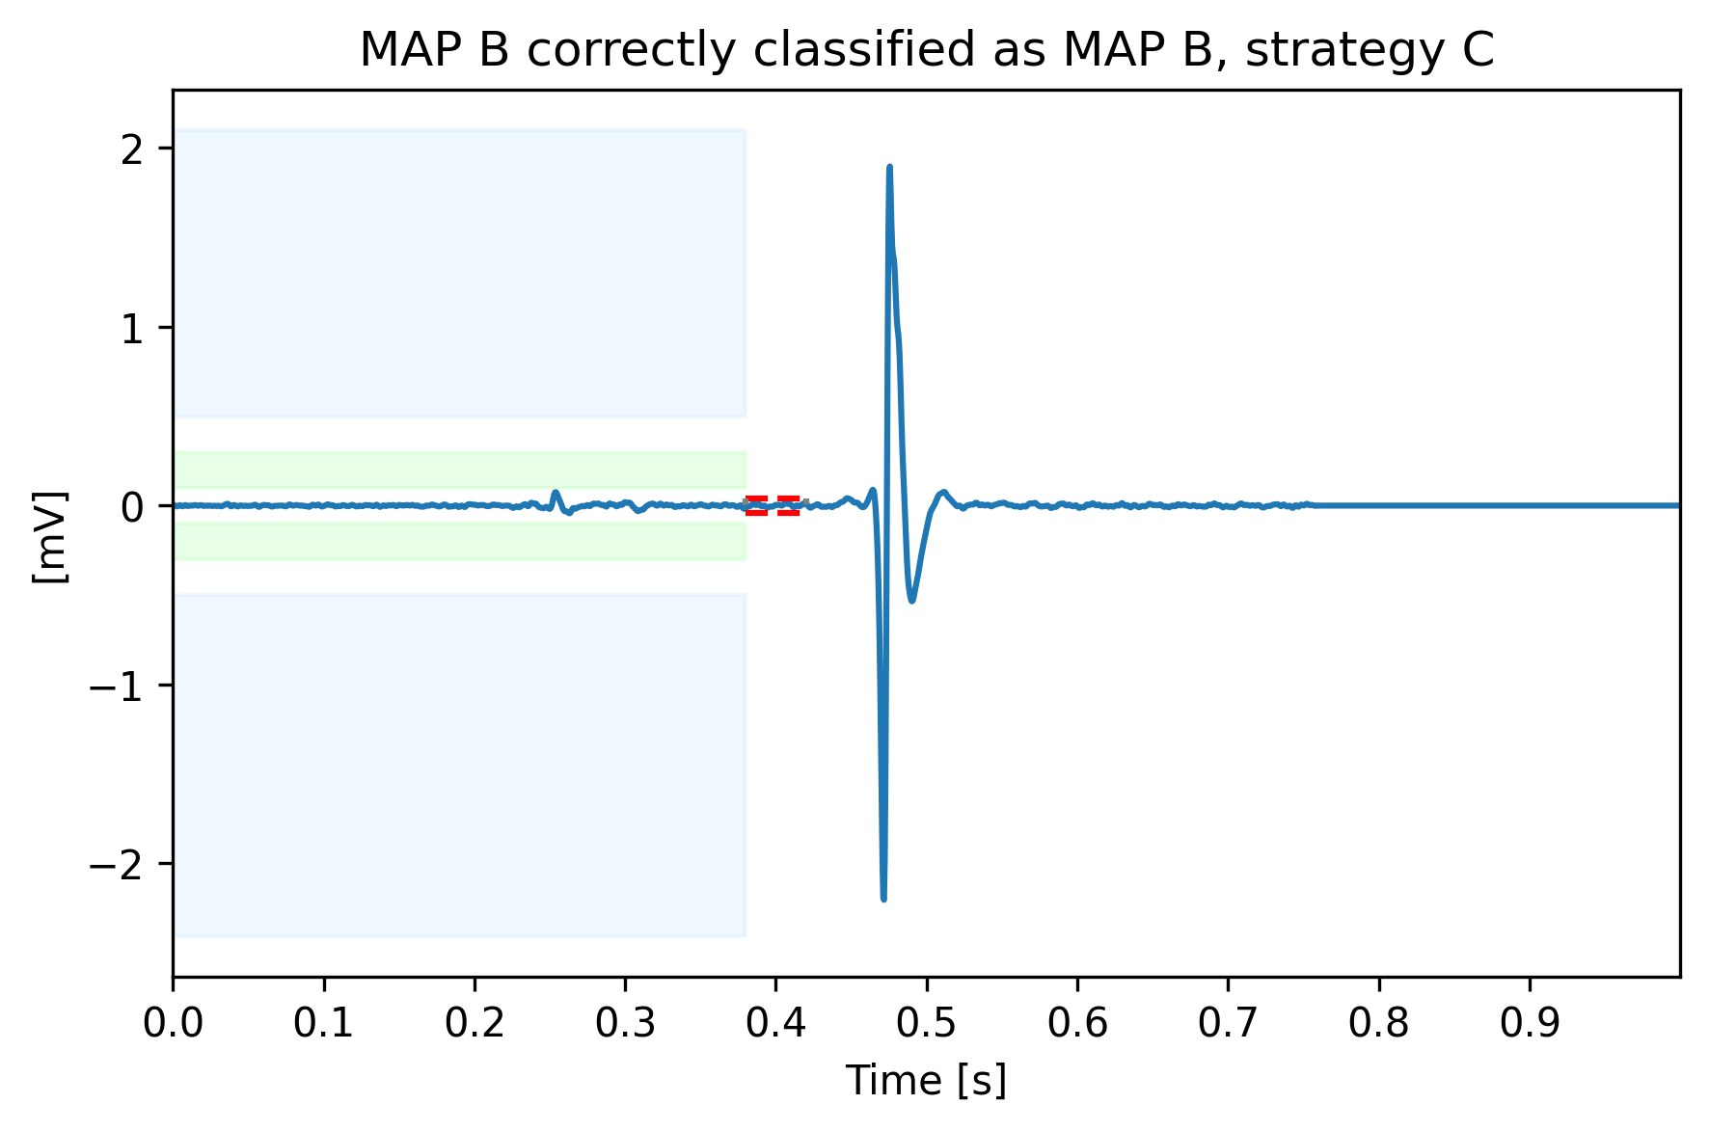
Correctly classified example 2
MAP B correctly classified
Higher ventricular peak is used to correctly assign this signal to map B.
Blue boxes: MAP A atrial peak threshold, green boxes MAP B atrial threshold, red dashed lines his peak thresholds

Slide 25
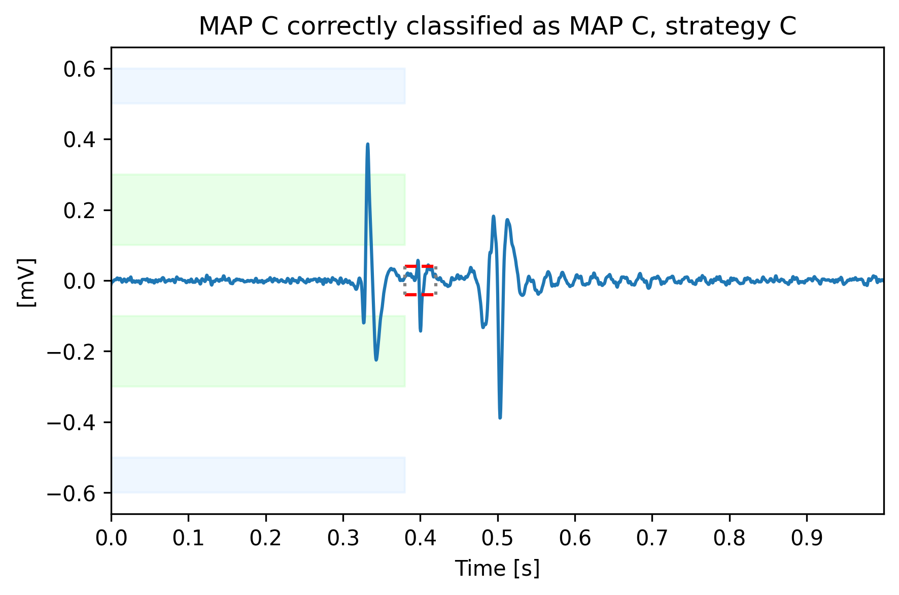
Correctly classified example 3
MAP C correctly classified
His bundle is correctly recognized and used to classify this signal into MAP C.
Blue boxes: MAP A atrial peak threshold, green boxes MAP B atrial threshold, red dashed lines his peak thresholds

Slide 26
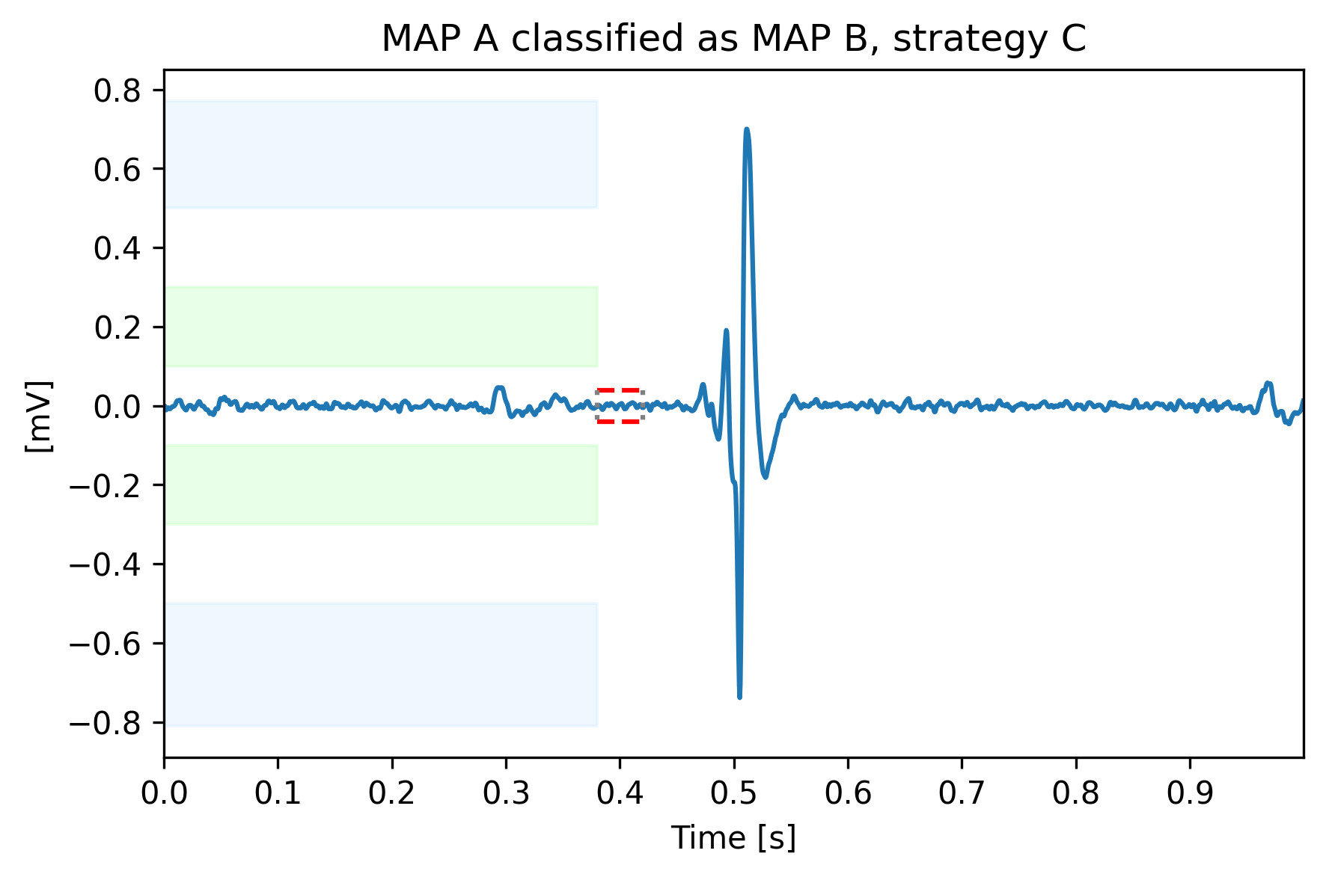
Misclassified example 1
MAP A classified as MAP B
The algorithm captures the uncertainty given by the clear Map B characteristics of the signal
Blue boxes: MAP A atrial peak threshold, green boxes MAP B atrial threshold, red dashed lines his peak thresholds

Slide 27
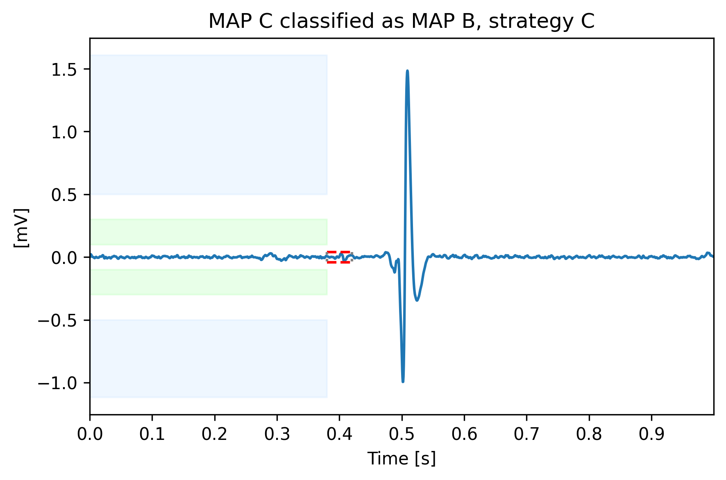
Misclassified example 2
MAP C classified as MAP B
Into this signal an His bundle oscillation is not clearly visible. Then, the signal is assigned to MAP B because of the higher ventricular peak
Blue boxes: MAP A atrial peak threshold, green boxes MAP B atrial threshold, red dashed lines his peak thresholds

Slide 28
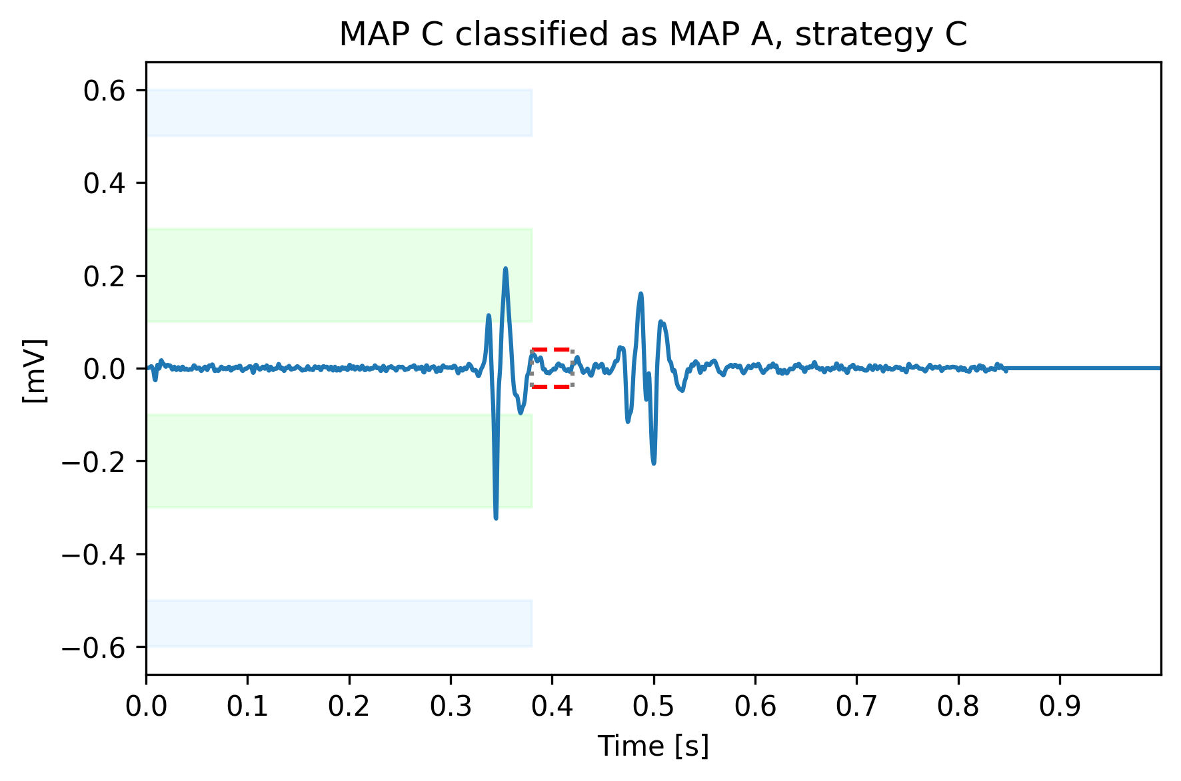
Misclassified example 3
MAP C classified as MAP A
His peak didn’t reach the threshold. Then, as it wasn’t considered significant, the signal is assigned to MAP A because of the higher atrial peak
Blue boxes: MAP A atrial peak threshold, green boxes MAP B atrial threshold, red dashed lines his peak thresholds

Slide 29
Outline
Why building a heuristic classifier
Knowledge on roving signals: recap
Data preparation
Heuristic classifier: pseudo code
Performance
Conclusions
Appendices

Slide 30
Conclusions
A heuristic classifier has been built with the purpose to act as baseline from which starting further evaluations.
In general, performance are not satisfying, as it could be imaged.
Looking at the confusion matrices and metrics, in both train and test sets:
MAP A has many FN classified as MAP B, probably due to ambiguous signals present into this class. Only temporal-spatial information is not sufficient to classify these signals properly. This situation is reflected by the good precision juxtaposed, however with low recall.
MAP B il classified well in terms or recall, but suffers of very low precision, because of the presence MAP A misclassified signals.
MAP C has low precision and recall, but at least half signals are correctly classified, leading to the conclusion that the threshold comparison result could be seen as a first hint to recognize these signals, even if clearly not sufficient.
The most important advantage of this algorithm is the full explainability of the process. In fact, the significance of the His Bundle peak can be easily explained, differently from what happened when built-in functions.
In conclusion the presented set of rules is a simple classifier, which can be used as baseline to start the classification with a true machine learning model.

Slide 31
Outline
Why building a heuristic classifier
Knowledge on roving signals: recap
Data preparation
Heuristic classifier: pseudo code
Performance
Conclusions
Appendices

Slide 32
Appendix 1: have been tried other strategies?
Strategy A
Prior: dominance between peaks
Peaks detection: find_peaks built-in function with prominence tuning applied on signal segments
First model used
Prominence not fully explainable
Strategy B
Prior: dominance between peaks
Peaks detection: max function and His threshold on His Segment
Best model in terms of performance
Full explainability
Prior not entirely used
Heuristic Classifier
Strategy B2
His threshold normalized respect to the signal amplitude
Strategy C
Prior: dominance between peaks and threshold on atrial phase
Peaks detection: max function and His threshold on His Segment
Almost all prior information are used
Respect to strategy B performance degradation is limited
Full explainability
Strategy C2
His threshold normalized respect to the signal amplitude

Slide 33
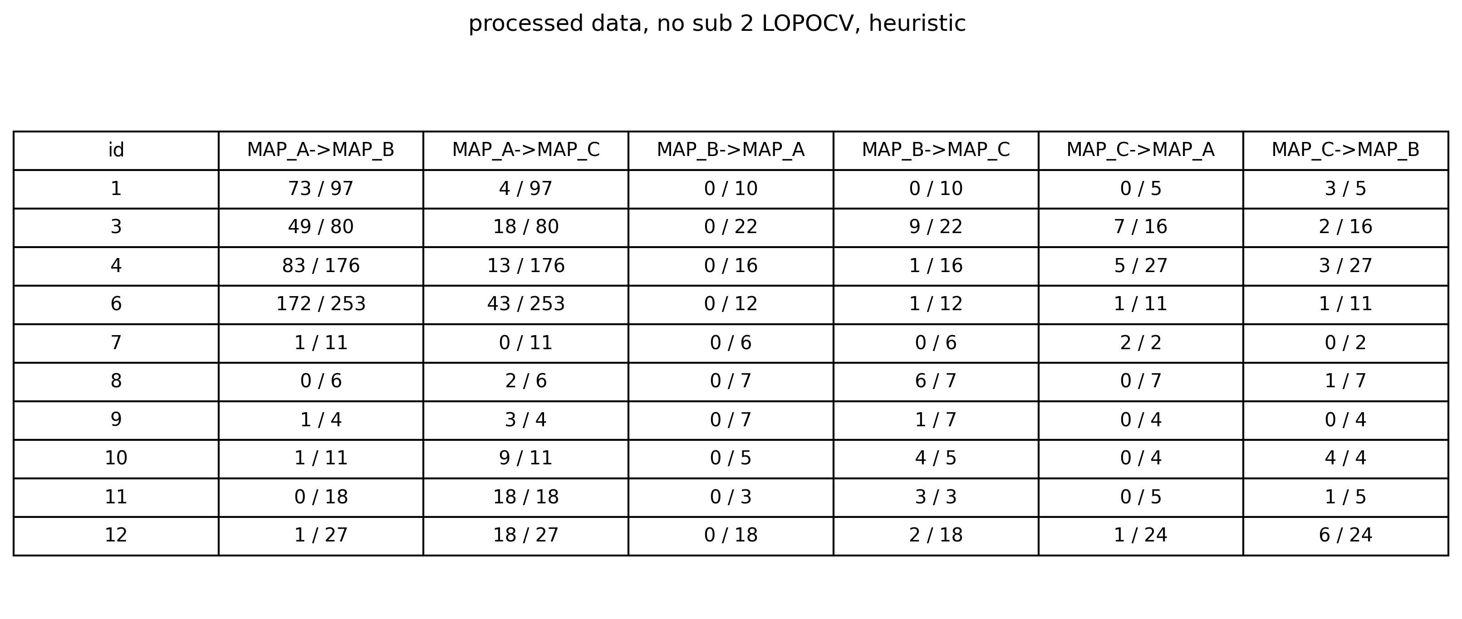
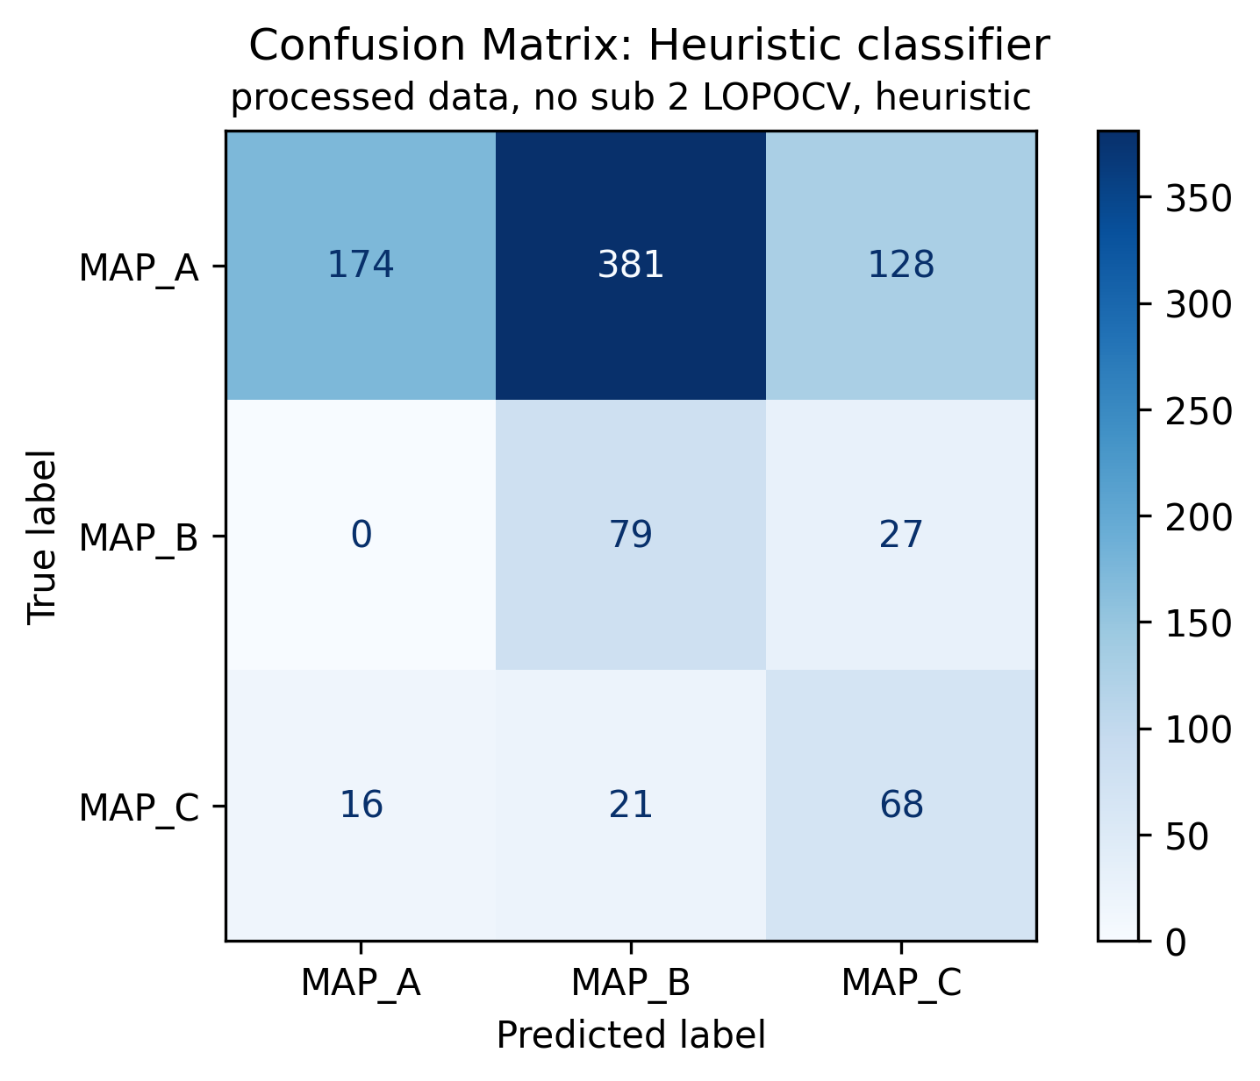
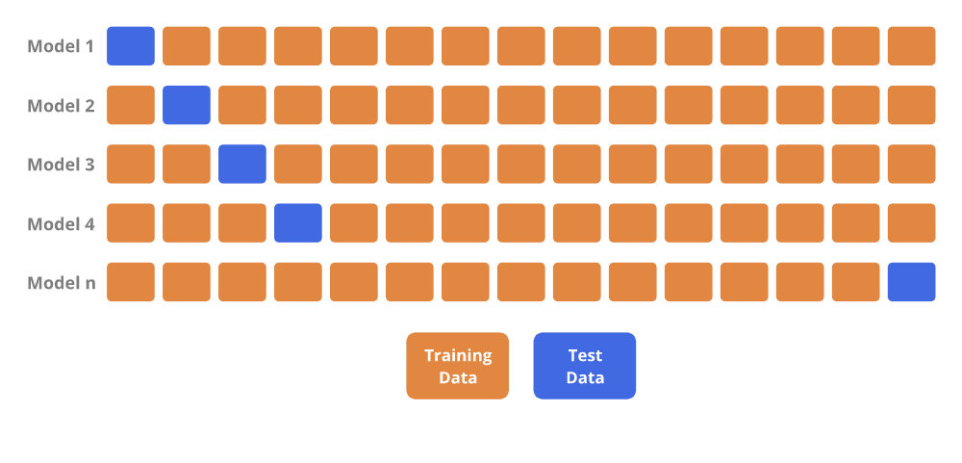
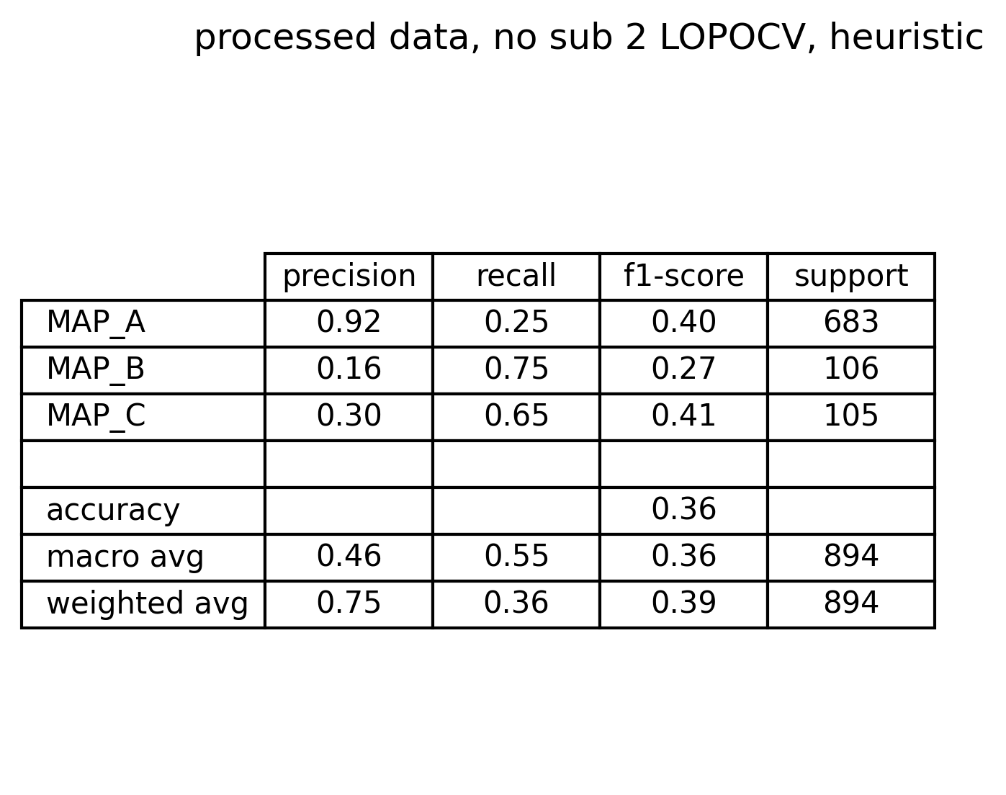
Appendix 2: what if LOPOCV is performed?
Instead of using a train/test split, one could try to match the inter-subject variability by using a Leave One Patient Out Cross Validation technique.
Iteratively, each patient is the test set while the others act as train set
The CM and the metrics summary are reported on the right.
Metrics are comparable with the ones obtained with train/test split
In addition, respect to train/test split, this strategy allow to check the number of misclassified signals for each subject and for each class.
Seems that some subjects carry the greatest number of misclassifications (1,3,4,6) from MAP A to MAP B
Moreover, same subjects have the highest rate of misclassification from MAP A to MAP C

Slide 34
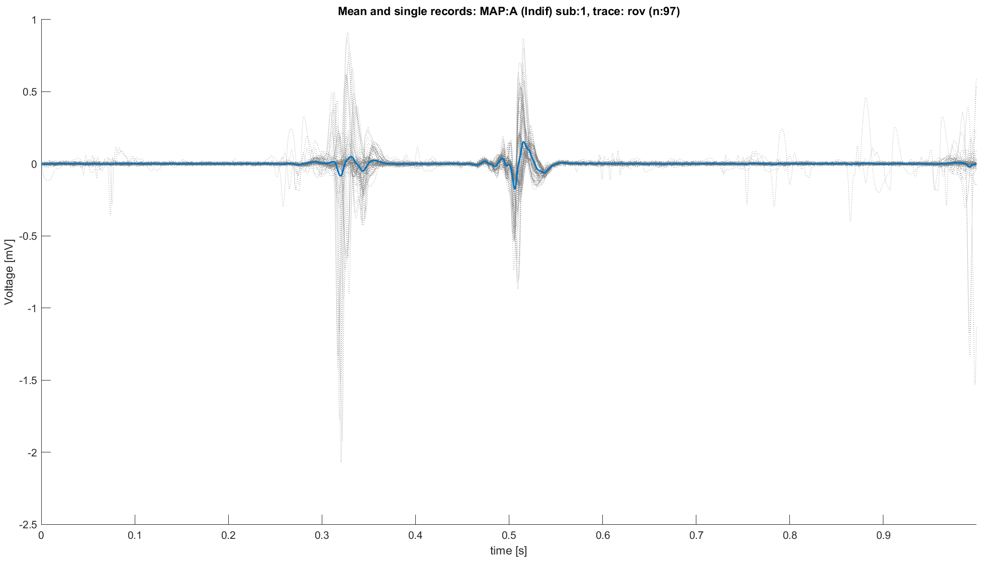
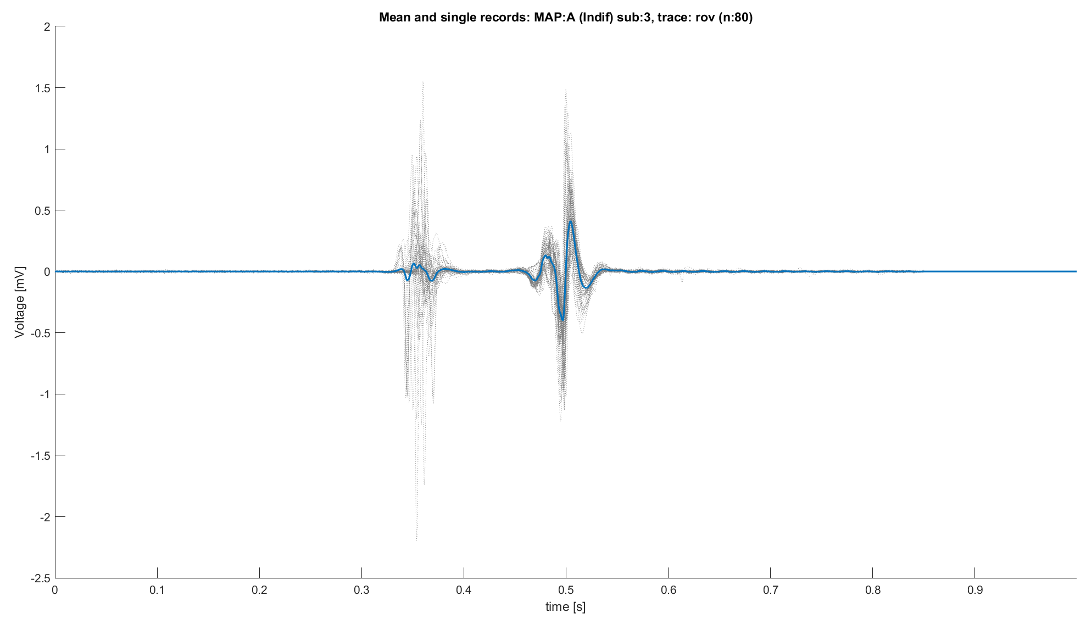
Appendix 3A: spaghetti plot of sub 1,3 MAP A
After Alignment sub 1
After Alignment sub 3
Misclassification due to presence of peaks into the ventricular part of the signal
Or due to edge peaks
Misclassification due to presence of peaks into the ventricular part of the signal

Slide 35
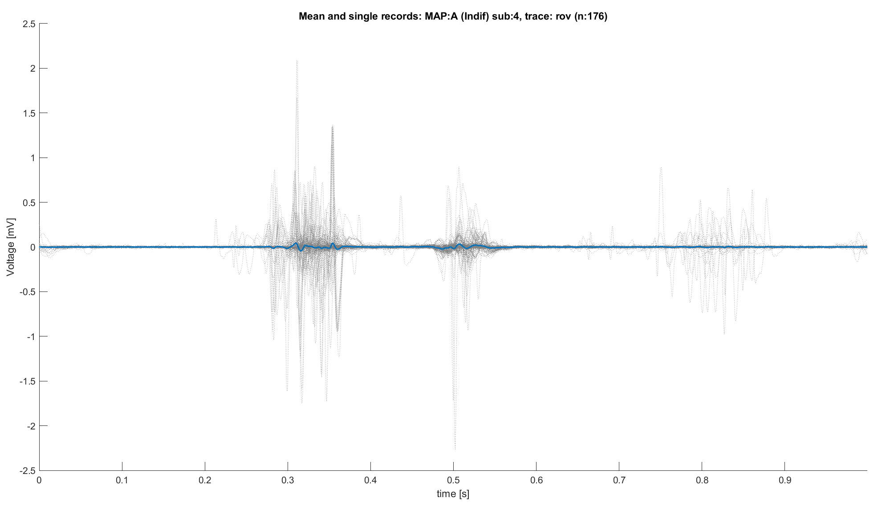
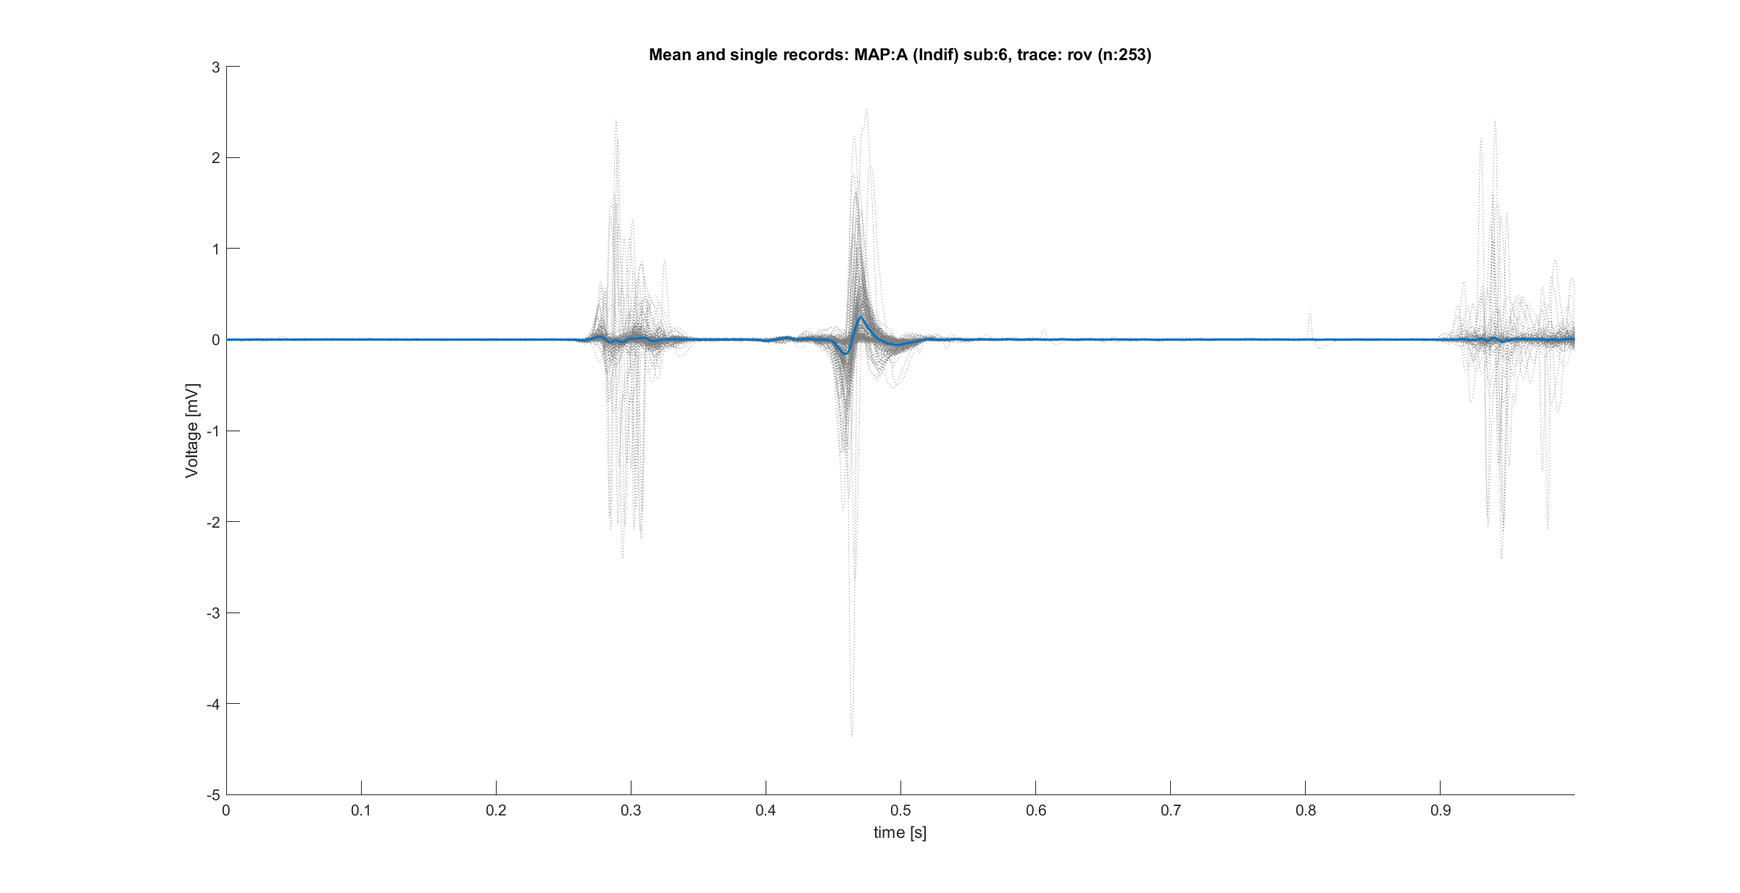
Appendix 3B: spaghetti plot of sub 4,6 MAP A
After Alignment sub 4
After Alignment sub 6
Misclassification due to presence of peaks into the ventricular part of the signal
Or due to edge peaks
Misclassification due to presence of peaks into the ventricular part of the signal
Or due to edge peaks

Slide 36
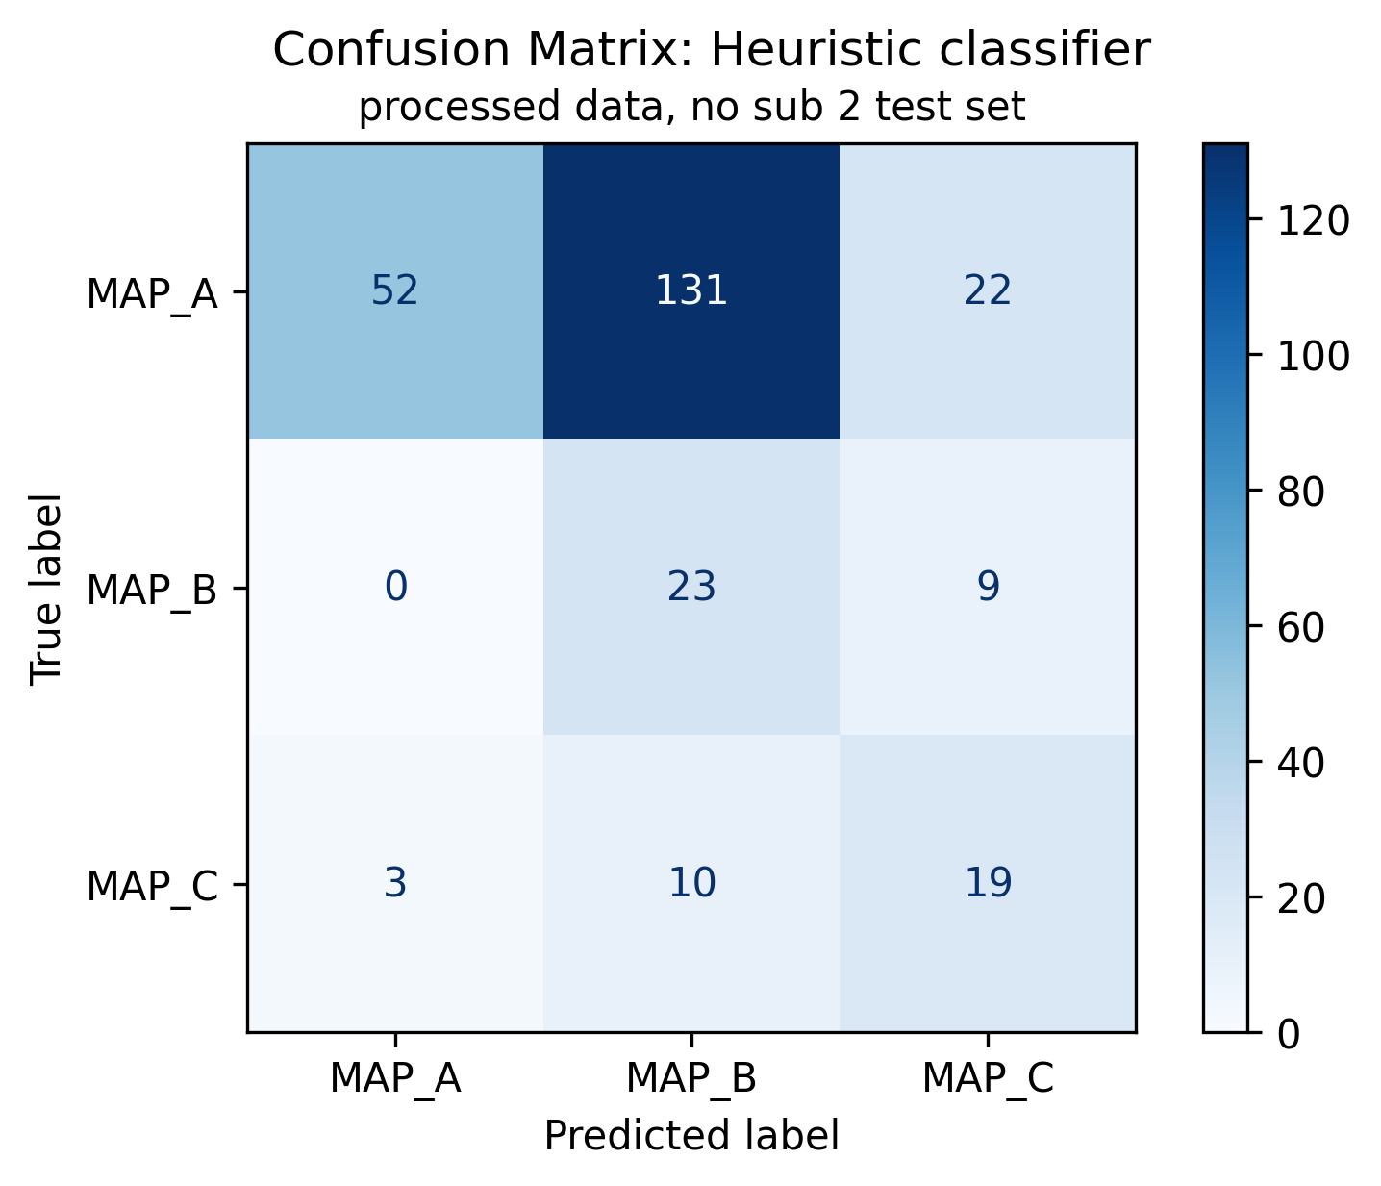
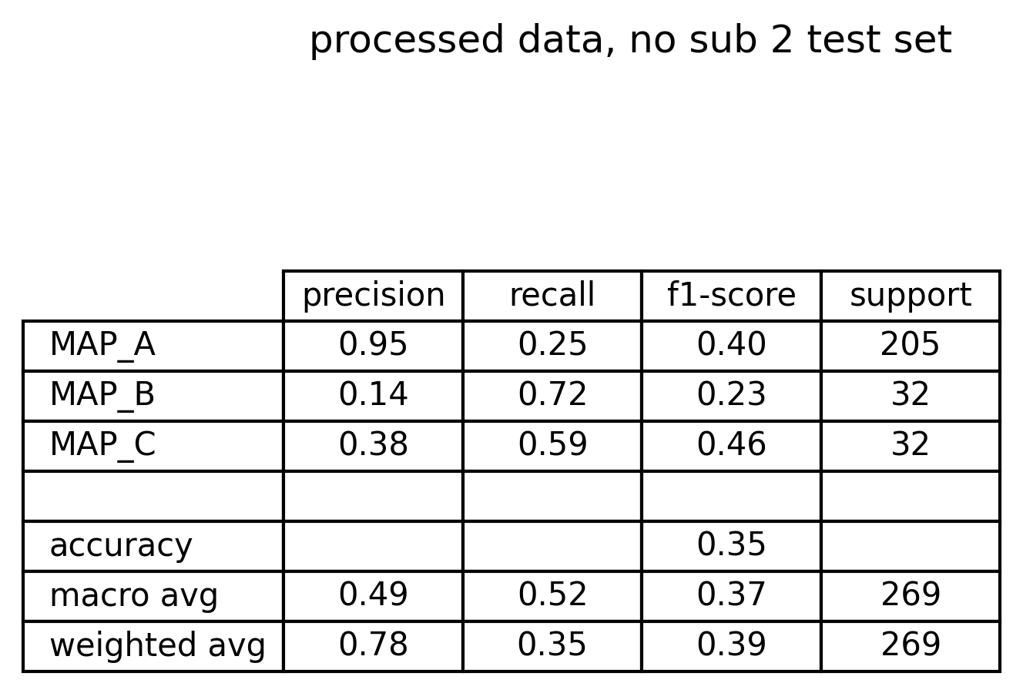

Appendix 4: What if ventricular phase is limited?
So far ventricular phase is defined as whatever follows 0.42 seconds, but some signals have evident artifacts from 0.6 seconds on.
So, if the ventricular segment is defined as
Ventricular phase: abs(record[t=0.42 : t=0.60 ])
would performance increase?
There are some improvements quantifiable with CM, performance metrics and, using LOPOCV, table of misclassified signals for each subject.
After Alignment sub 4

Slide 37
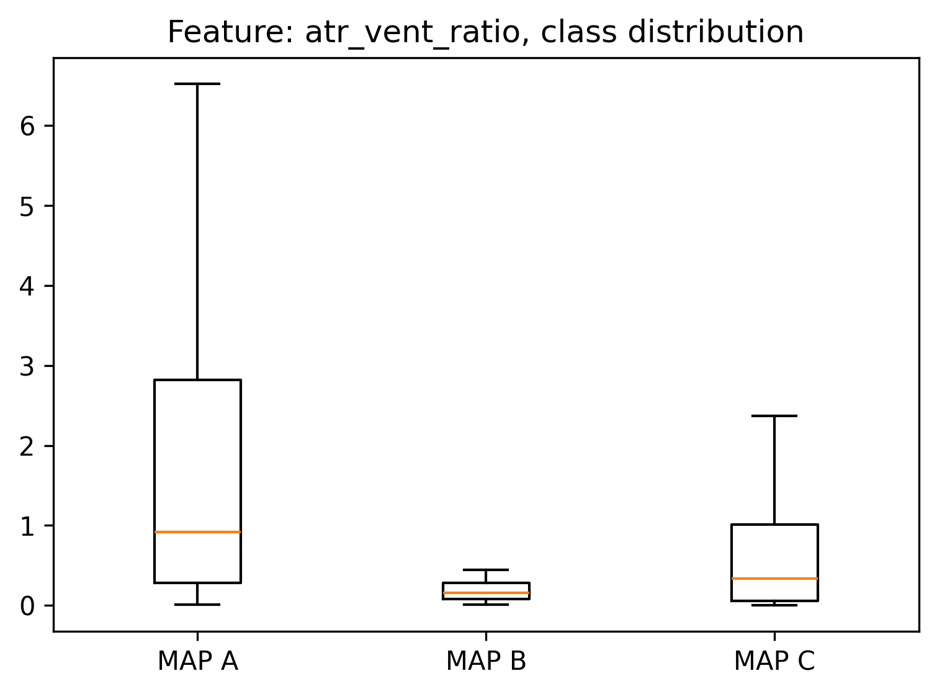
Appendix 5: are peaks subject specific?
By evaluating the ratio between the atrial peak and the ventricular peak one could try to find out if there are differences between MAP A and MAP B into this feature.
From boxplots seems that this feature could be slightly discriminative, even if a certain grade of overlap can be recognized.
Such fact suggest that the ratio between peaks might be subject specific.

